Slide 1

Database Processing: Fundamentals, Design, and Implementation
15th Edition
Week 10 – Part 2
Transforming Data Models into Database Designs

Slide 2
The Database Design
A data model is transformed into a database design.
A database design is a set of database specifications that can actually be implemented as a database in a specific DBMS product.
While the data model is a generalized, non-DBMS-specific design, a database design is a DBMS-specific design intended to be implemented in a DBMS product such as Microsoft SQL Server or Oracle Database.

Slide 3
Database Design = Logical Design + Some Physical Design
Books on systems analysis and design often identify three design stages:
Conceptual design (conceptual schema)
Logical design (logical schema)
Physical design (physical schema)
The database design we are discussing is equivalent to the logical design plus some physical design elements (data types)

Slide 4
Steps for Transforming a Data Model into a Database Design (1 of 3)
Transforming a Data Model into a Database Design
1. Create a table for each entity:
- Specify the primary key (consider surrogate keys, as appropriate)
- Specify alternate keys
- Specify properties for each column:
* Null status
* Data type
* Default value (if any)
* Data constraints (if any)
- Verify normalization

Slide 5
Steps for Transforming a Data Model into a Database Design (2 of 3)
Transforming a Data Model into a Database Design (Cont.)
2. Create relationships by placing foreign keys
- Relationships between strong entities (1:1, 1:N, N:M)
- Identifying relationships with ID-dependent entities (intersection tables, association patterns, multivalued attributes, archetype/instance patterns)
- Relationships between a strong entity and a weak but non-ID-dependent entity (1:1, 1:N, N:M)
- Mixed relationships
- Relationships between supertype/subtype entities
- Recursive relationships (1:1, 1:N, N:M)

Slide 6
Steps for Transforming a Data Model into a Database Design (3 of 3)
Transforming a Data Model into a Database Design (Cont.)
3. Specify logic for enforcing minimum cardinality
- O-O relationships
- M-O relationships
- O-M relationships
- M-M relationships

Slide 7
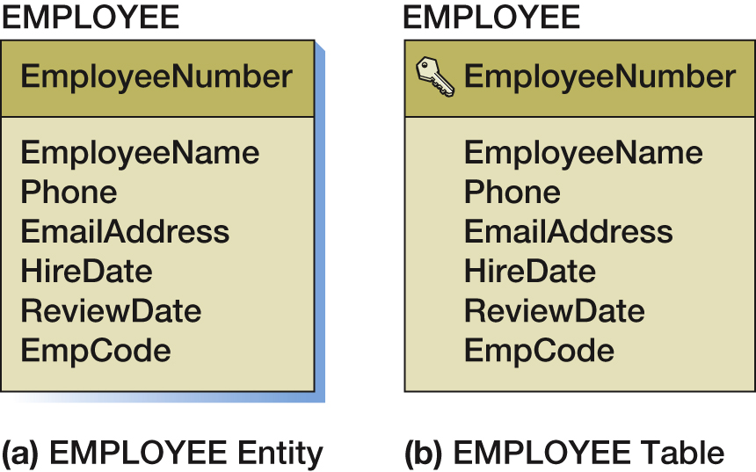
Create a Table for Each Entity
EMPLOYEE (EmployeeNumber, EmployeeName, Phone, EmailAddress, HireDate,
ReviewDate, EmpCode)

Slide 8
Selecting the Primary Key
The ideal primary key is short, numeric, and fixed.
Surrogate keys meet the ideal, but have two disadvantages to users:
They have no meaning to users (an ID used as a surrogate key may give no indication of the related table)
When data is shared with among different databases (an ID used in one database may have no meaning to a user in another database)

Slide 9
Specify Alternate (Candidate) Keys
The terms candidate key and alternate key are synonymous.
Candidate keys are alternate identifiers of unique rows in a table.
Will use AKn.m notation, where n is the number of the alternate key, and m is the column number in that alternate key.

Slide 10
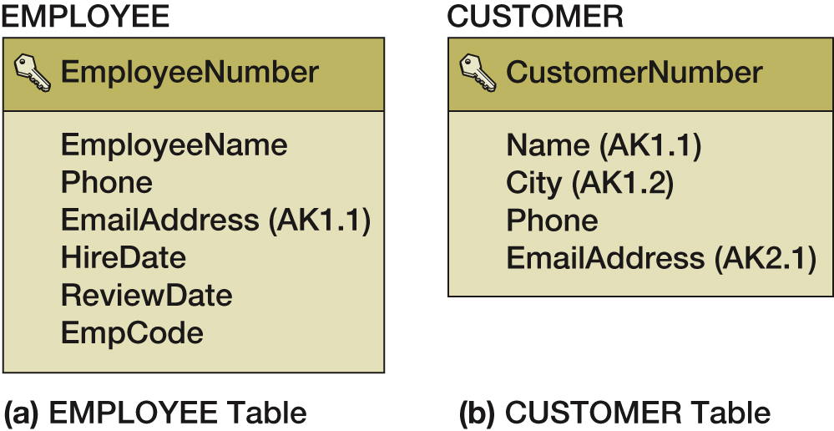
Representing Alternate Keys

Slide 11
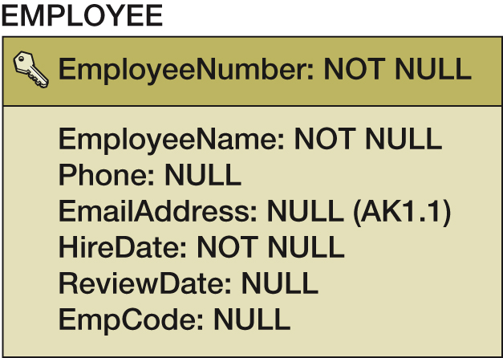
Specify Column Properties: Null Status
Null status indicates whether or not the value of the column can be NULL.

Slide 12
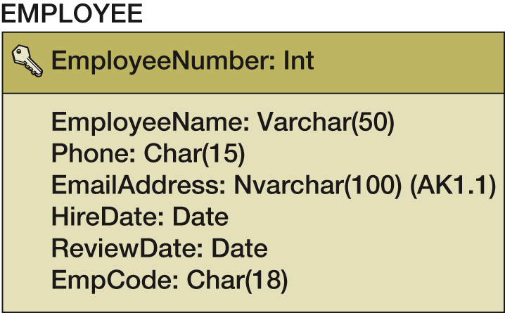
Specify Column Properties: Data Types
Generic data types:
Char(n)
Varchar(n)
Date
Time
Integer
Decimal(m,n)
Numeric(m,n)
Money(m,n)

Slide 13
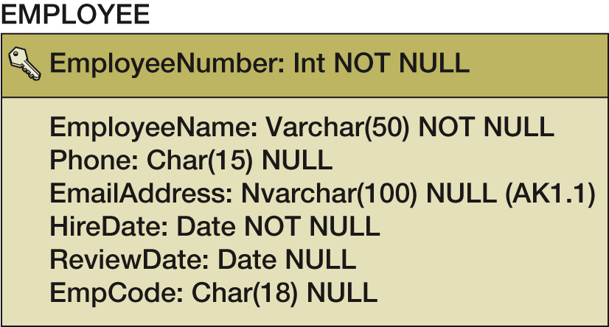
Specify Column Properties: Date Type and Null Status

Slide 14
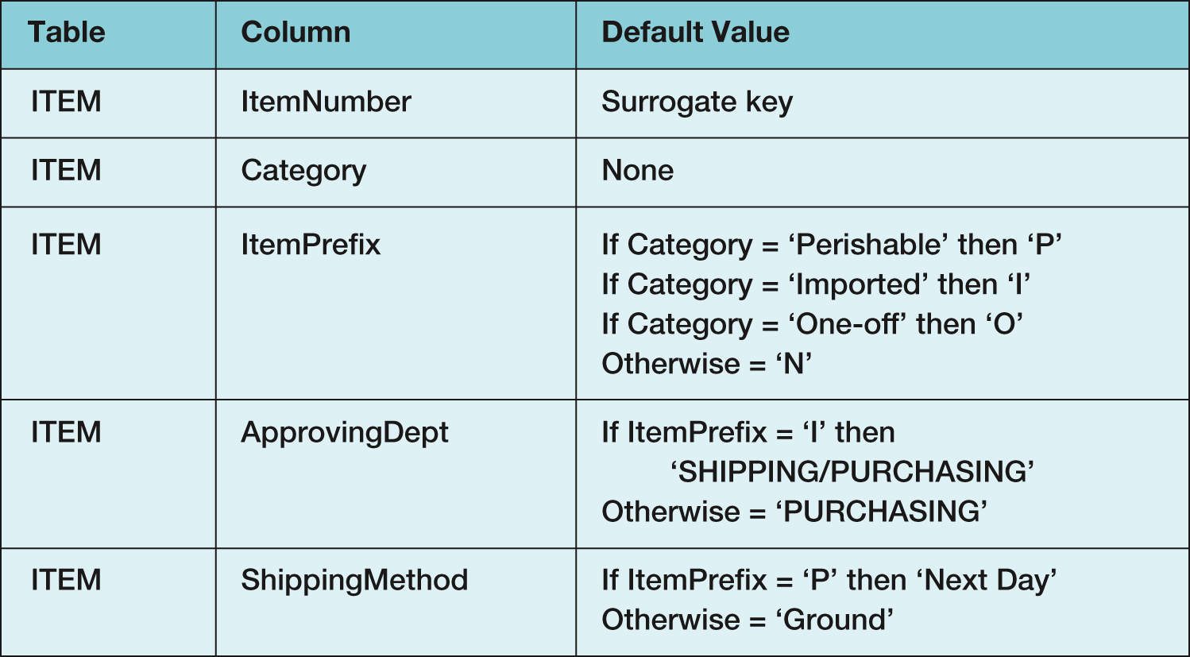
Specify Column Properties: Default Values
A default value is the value supplied by the DBMS when a new row is created.

Slide 15
Specify Column Properties: Data Constraints
Data constraints are limitations on data values:
Domain constraints limit column values to a particular set of values.
Range constraints limit values to a particular interval of values (within a given range).
Intrarelation constraints limit a column’s values in comparison to values in other columns in the same table.
Interrelation constraints limit a column’s values in comparison to values in other columns in other tables (referential integrity constraints on foreign keys).

Slide 16
Verify Normalization
The tables should be normalized based on the data model.
Verify that all tables are in either:
BCNF
4NF

Slide 17
Create Relationships: 1:1 Strong Entity Relationship (1 of 2)
Place the primary key of one entity in the other entity as a foreign key.
Either design will work—no parent, no child
Minimum cardinality considerations may be important
O-M will require a different design than M-O
One design will be very preferable

Slide 18
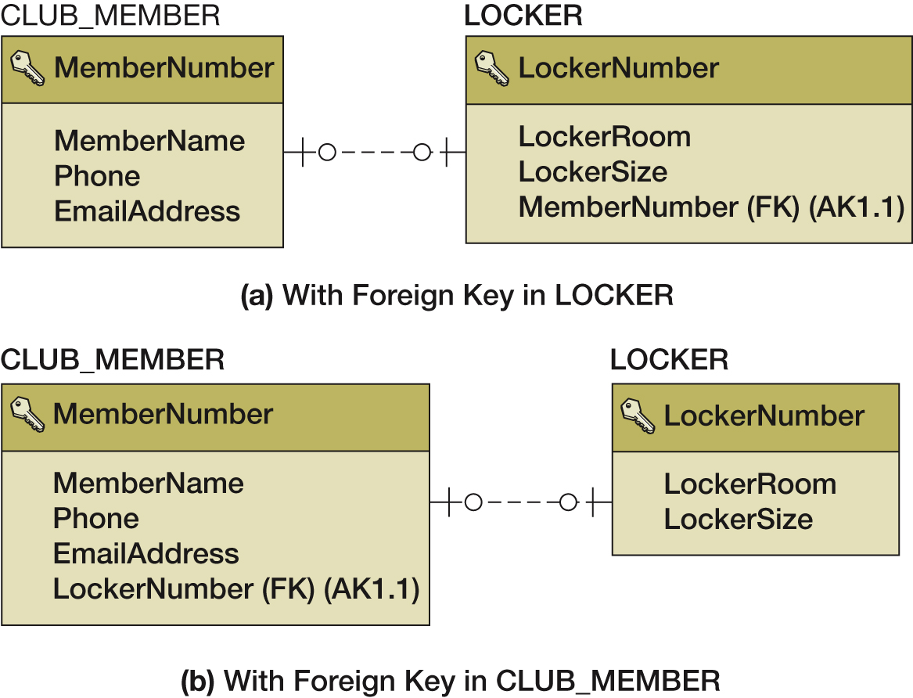
Create Relationships: 1:1 Strong Entity Relationship (2 of 2)

Slide 19
Create Relationships: 1-N Strong Entity Relationships (1 of 2)
Place the primary key of the table on the one side of the relationship into the table on the many side of the relationship as the foreign key.
The one side is the parent table and the many side is the child table, so “place the key of the parent in the child.”

Slide 20
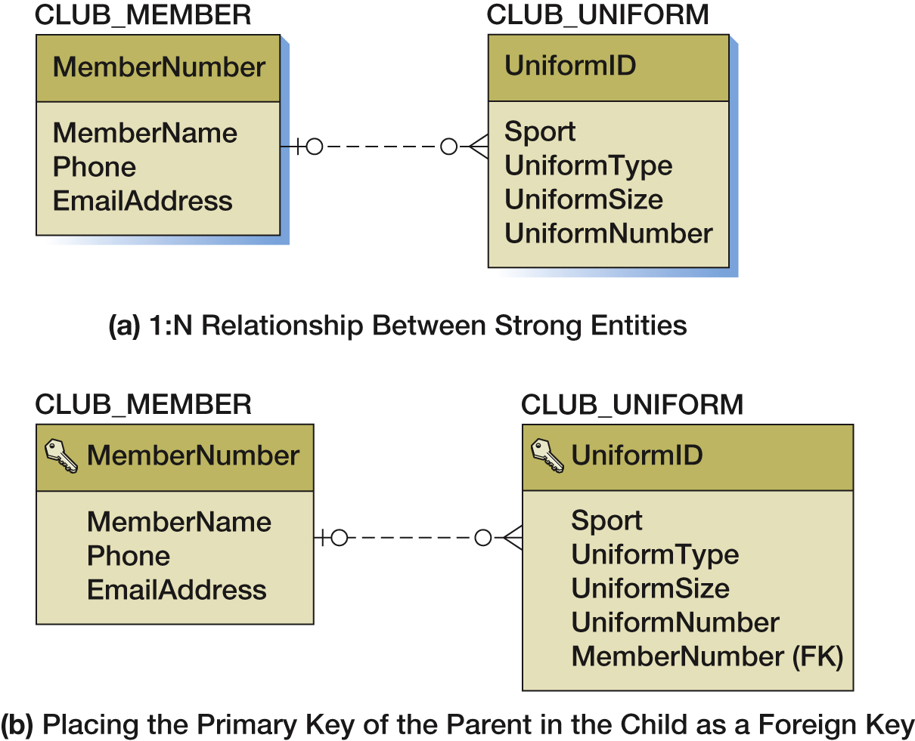
Create Relationships: 1-N Strong Entity Relationships (2 of 2)

Slide 21
Create Relationships: N:M Strong Entity Relationships (1 of 2)
In an N:M strong entity relationship there is no place for the foreign key in either table.
A COMPANY may supply many PARTs
A PART may be supplied by many COMPANYs
The solution is to create an intersection table that stores data about the corresponding rows from each entity.
The intersection table consists only of the primary keys of each table which form a composite primary key.
Each table’s primary key becomes a foreign key linking back to that table.
COMPANY_PART_INT (CompanyName, PartNumber)

Slide 22
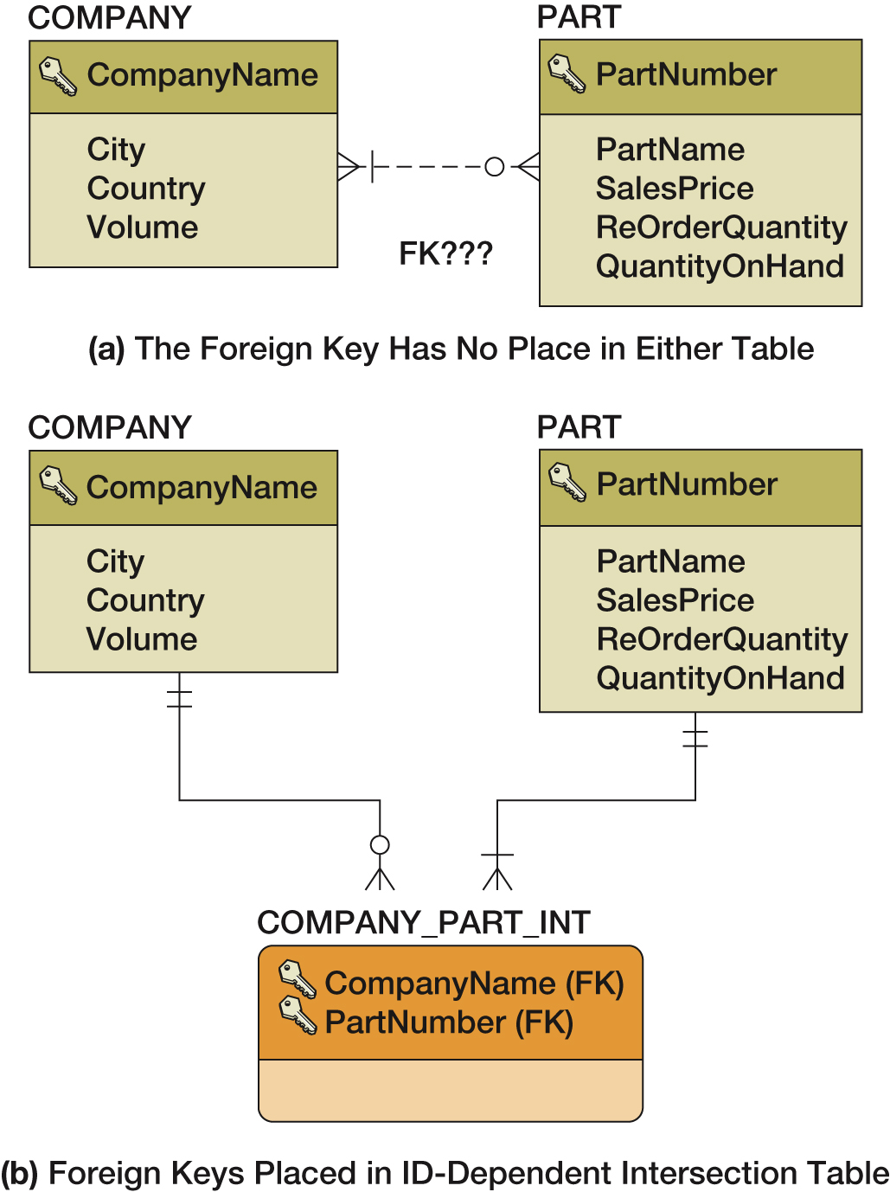
Create Relationships: N:M Strong Entity Relationships (2 of 2)

Slide 23
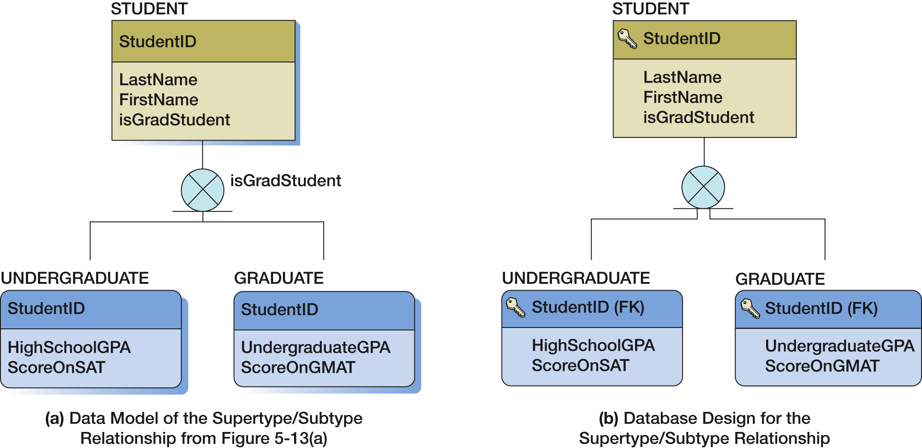
Supertype/Subtype Entities

Slide 24
Database Processing Fundamentals, Design, and Implementation (15th Edition)
End of Presentation:
Week #10
Part 2

